Slide 1
Maryland Compatible Energy Siting Project
Maryland Department of Commerce

Slide 2
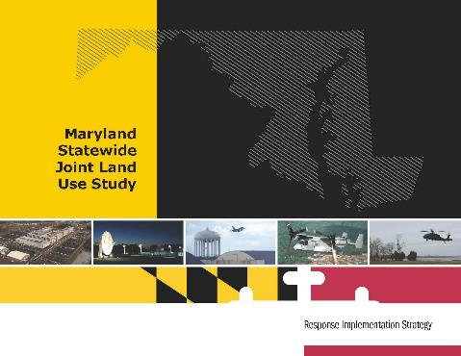
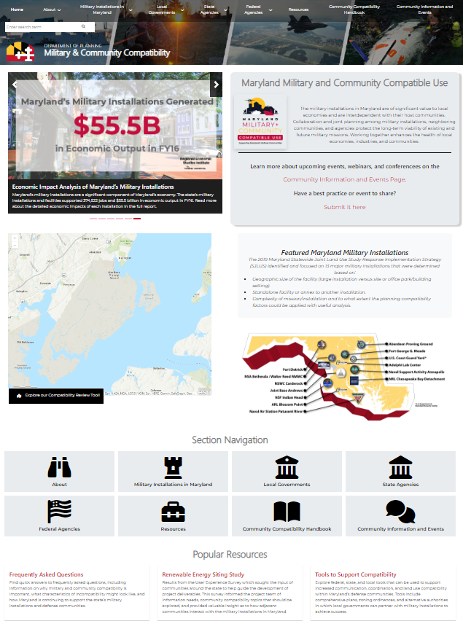
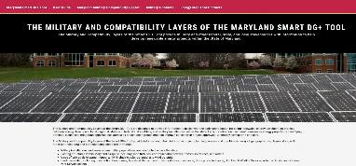
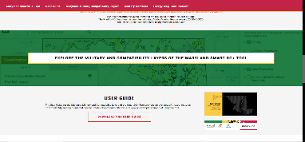
How We Got Here: Maryland’s Compatible Use Plan
Three Phases
Phase 1a
Plan Statewide Joint Land Use Response Implementation Strategy (SJRIS)
Phase 1b
Organize Compatible Use Planning Committee
Phase 2
Implement Statewide Compatible Use Project
(Wrapping up December 2022)
Phase 3
Maintain and improve practices implemented in Phase 2
Notes:
Started Phase 1a back in 2017 with a grant from the Office of Local Defense Community Cooperation (or OLDCC) with goal to identify and recommend actions that the state could take to address common compatibility issues between installations and surrounding communities in the state.
After SJRIS completed, an organizing and planning period led to the creation and implementation of the Statewide Compatible Use Project in 2020 which brought the Dept of Planning on as key project partner and another grant from OLDCC was received to implement these activities, including the Compatible Energy Siting Project and the Compatible Use website which Sarah is going to be reviewing.
This project is wrapping up and will be sharing deliverables from that project in today’s presentation.
Phase 3 – next steps

Slide 3
What is the Maryland Compatible Energy Siting Project?
A collaborative process between:
Provide information and tools to mitigate potential compatibility conflicts early in the renewable energy development siting process
  Military & Compatibility Layers for the Maryland Department of Natural Resources, Power Plant Research Program’s existing online SmartDG+ renewable energy screening tool:
  Show areas of military operations
  Improve awareness of possible development conflicts prior to a renewable energy developer’s purchase or lease of land
  Provide information for early coordination with the military to assist renewable energy developers with decision-making when making land purchases or leasing decisions
    Project Report with recommendations on enhancing existing siting approval processes to facilitate compatibility with military operations
State departments and agencies | Regional military partnership organizations
Local governments | Renewable energy industry
Military installations and facilities
Notes:
This collaborative process involved a steering committee that met 7x over the course of a year
Chose to enhance an existing tool rather than create a new one because developers were already using the Smart DG+ tool, so built in user base, and because it was more cost effective

Slide 4
Why is the Project Important?
Help achieve State of Maryland’s clean energy mandates
Protect and sustain military operations and their economic contribution to the State of Maryland
Facilitate streamlining of renewable energy development to save developers time and money
Facilitate ongoing community economic prosperity
Protect public health and safety
Notes:
MD clean energy mandate of 100% clean energy by 2040
Economic impact from the military totaled $55.5B in FY16

Slide 5
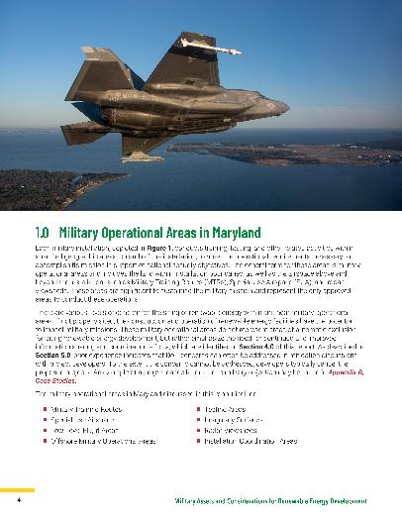
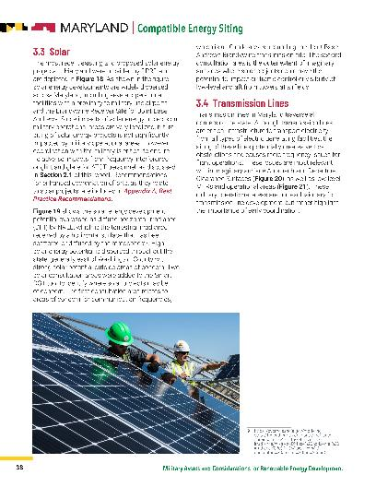
Project Report: Overview
Characterizes military operations
Explains military operations in relation to renewable energy development
Provides recommendations to improve existing coordination between energy developers and the military for compatible siting of renewable energy projects
Includes two case studies of how SmartDG+ can enhance existing coordination processes with the military and improve compatible siting of renewable energy projects
Provides guidance language to local governments for renewable energy model ordinances
Notes:
Military operations in relation to renewable energy development means how operations can be affected by or affect renewable energy projects
18 recommendations to improve existing coordination practices included to improve existing coordination between developers and the military. Report identifies responsible parties - mostly at a local level.
Case studies in St. Mary’s County and Caroline County
Guidance language for communities who do not have ordinances and wish to develop

Slide 6
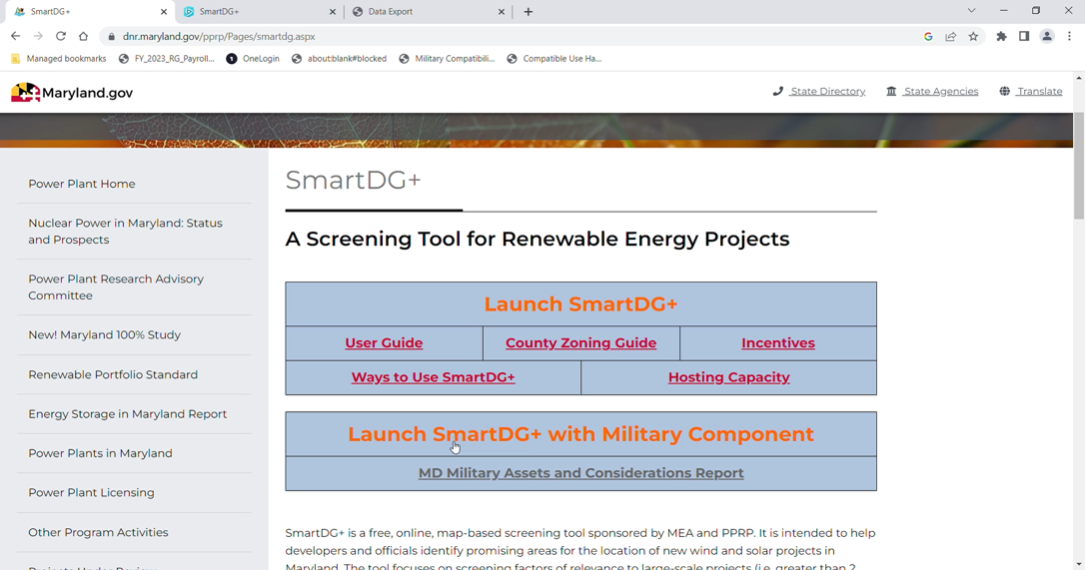
Enhanced Smart DG+ Tool Demo

Slide 7

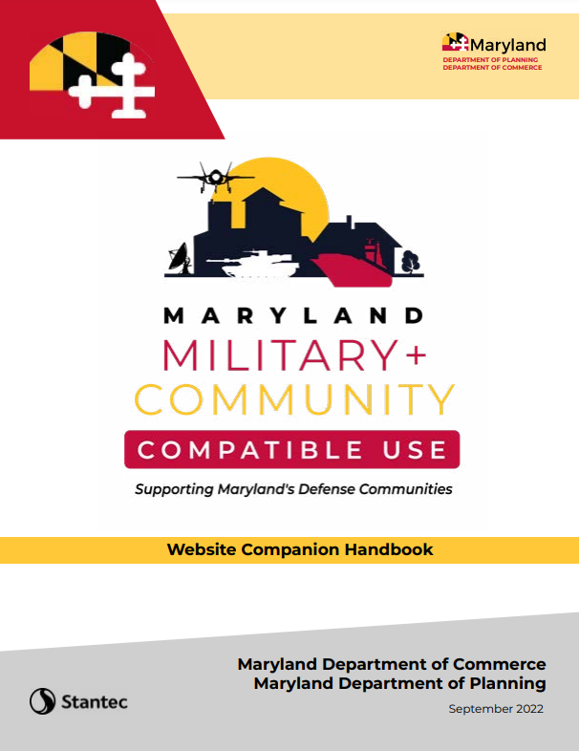
Compatible Use Website and Handbook
Land use technical assistance and guidance for local planners on compatible use issues
Purpose: Raise awareness of the economic impact of the military mission in Maryland and build community engagement while providing local communities with the tools and resources they need to ensure compatible use with military operations in their community.
Resources guide and facilitate the implementation of recommendations from the 2019 Statewide Joint Land Use Response Implementation Strategy (SJRIS).
Target audience: military communities and members, state and local leaders, community organizations, and the general public.
Website Tabs
About
Military Installations in MD
Local Governments
State Agencies
Federal Agencies
Resources
Community Compatibility
Handbook
Community Information
and Events

Slide 8

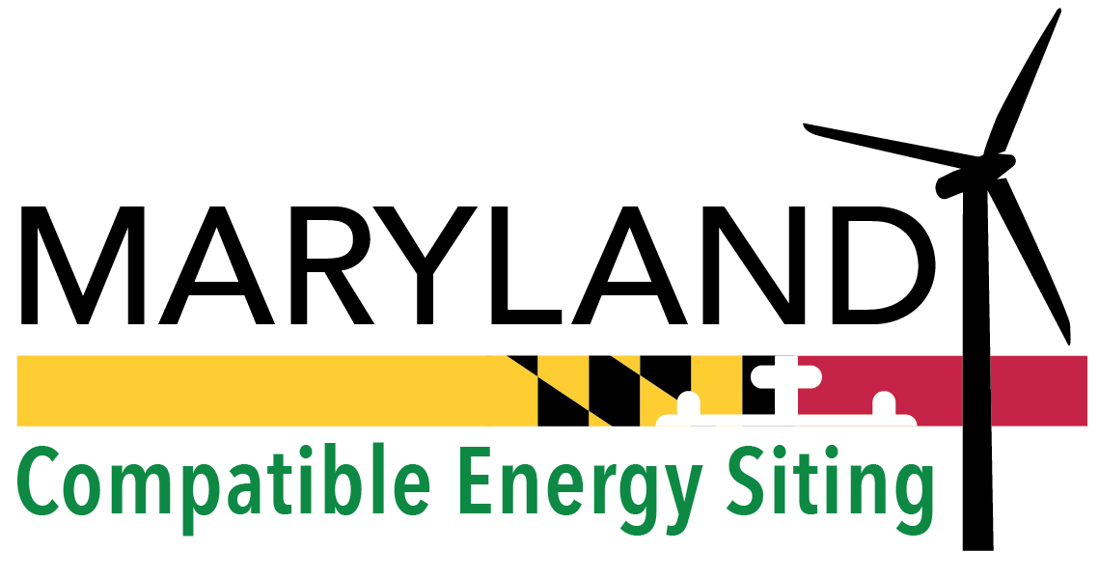

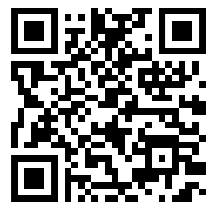
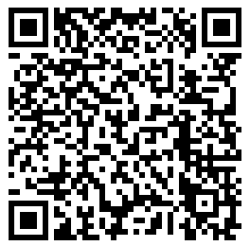
Thank you!
Jennifer Chiasson
Senior Grant Manager, Office of Military and Federal Affairs
Jennifer.Chiasson@maryland.gov | 410-767-6445
Additional project information can be found here: https://commerce.maryland.gov/compatibleuse
Sarah Diehl
Compatible Use Community Planning Liaison
sarah.diehl@maryland.gov | 410-767-4547
Website coming soon at:
militarycompatibility.maryland.gov
Notes:
QR code links to Smart DG+ tool homepage where military & compatibility data can be found. Report is also on that page.
Planning QR code navigates to Compatible Use Handbook.
Future URL for Compatible Use website at the bottom (will be launched next week)

