Slide 1

Maryland Military / Community Compatibility Website and Handbook
Purposes
  Raise awareness of mission and economic impact of the military in Maryland
  Provide local communities with the tools and resources they need to ensure compatible use with military operations in their community
  A forum to engage to communicate updates to the community and military stakeholders
Maryland Department of Planning Project Lead
Support from the Maryland Department of Commerce Office of Military & Federal Affairs
Funded by a grant through the DoD Office of Local Defense Community Cooperation

Slide 2
Maryland Military Community Compatibility Website And Handbook
Website Highlights
  Monitored user forum – users must register, no anonymous posts
  Link to Maryland’s GIS data
    Map major installations, State Guard and Reserve Centers
    Information templates for 12 major DoD installations
    Information data layers to support military/community compatibility planning
    Link to Energy study maps and data
  Includes best practices, success stories, existing JLUS documents, and other tools and resources to support compatibility planning

Slide 3
Maryland Military Community Compatibility Website And Handbook
Handbook will be a condensed overview of the website contents
Electronic version for ease of use
  Users can download and print
We are getting up-front input
  Policy Stakeholder Group
  Implementation Stakeholder Group
  Focus groups comprised of military, industry, and community members
  Survey / Questionnaire

Slide 4
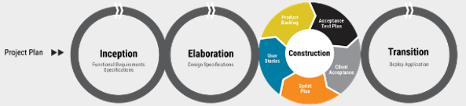
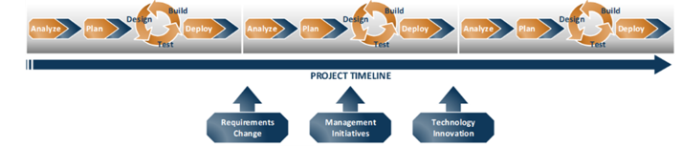
Maryland Military Community Compatibility Website And Handbook
Website development using DevOps and Sprints

Slide 5
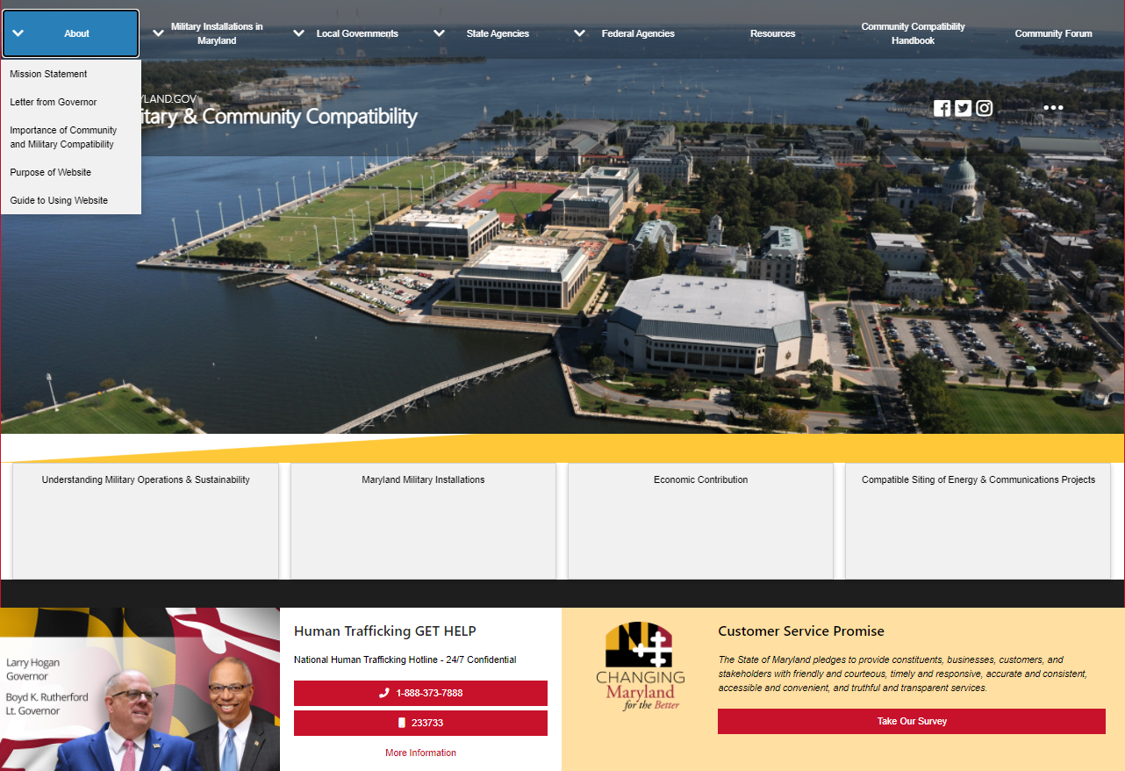


Slide 6
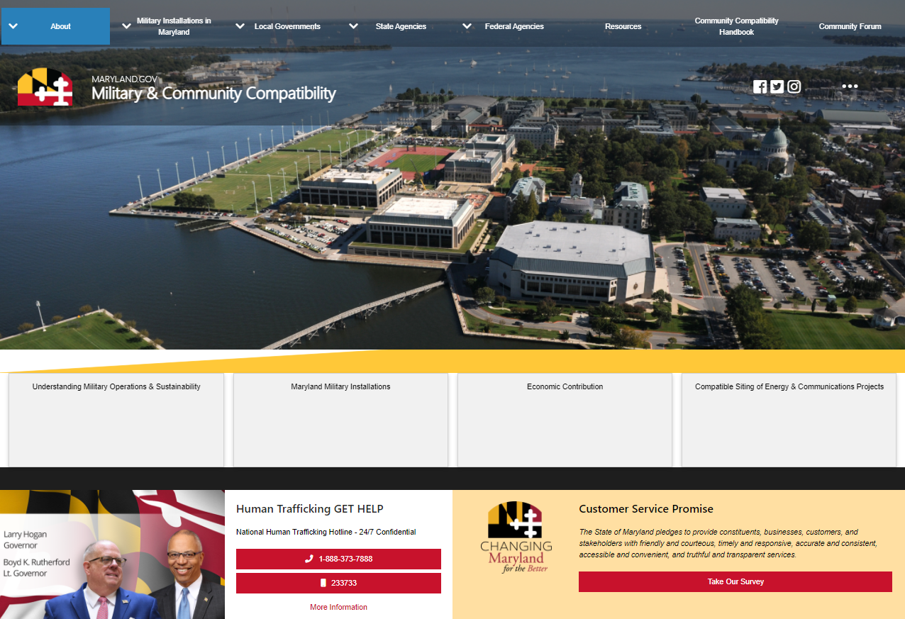
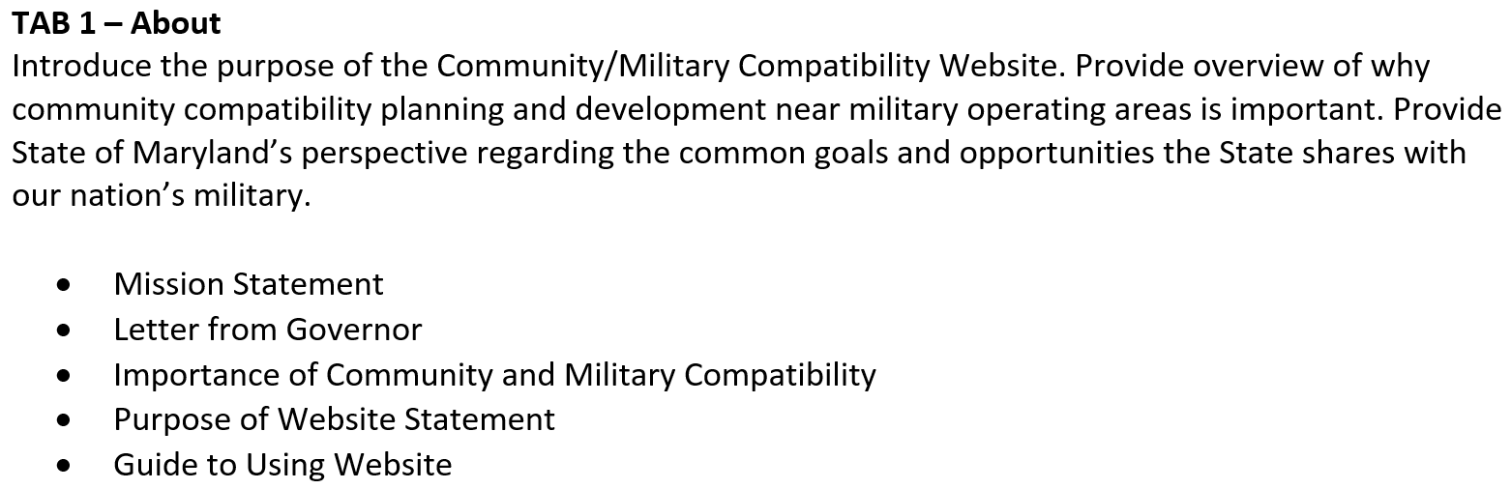

Slide 7

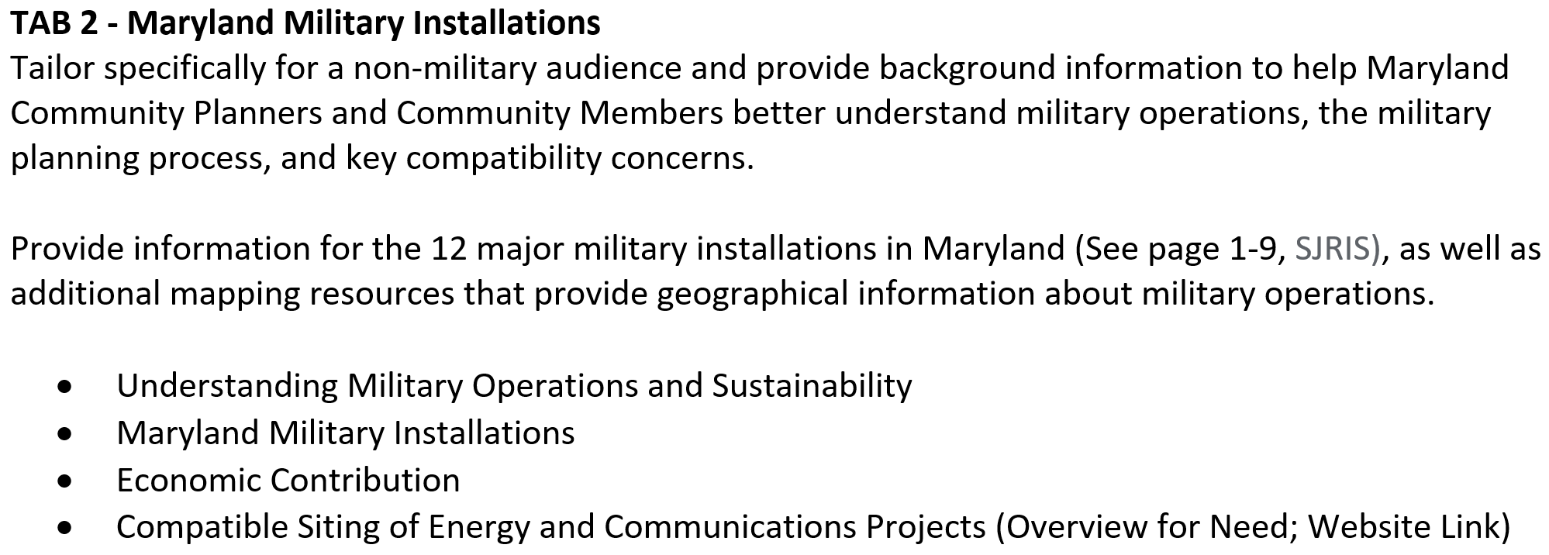

Slide 8

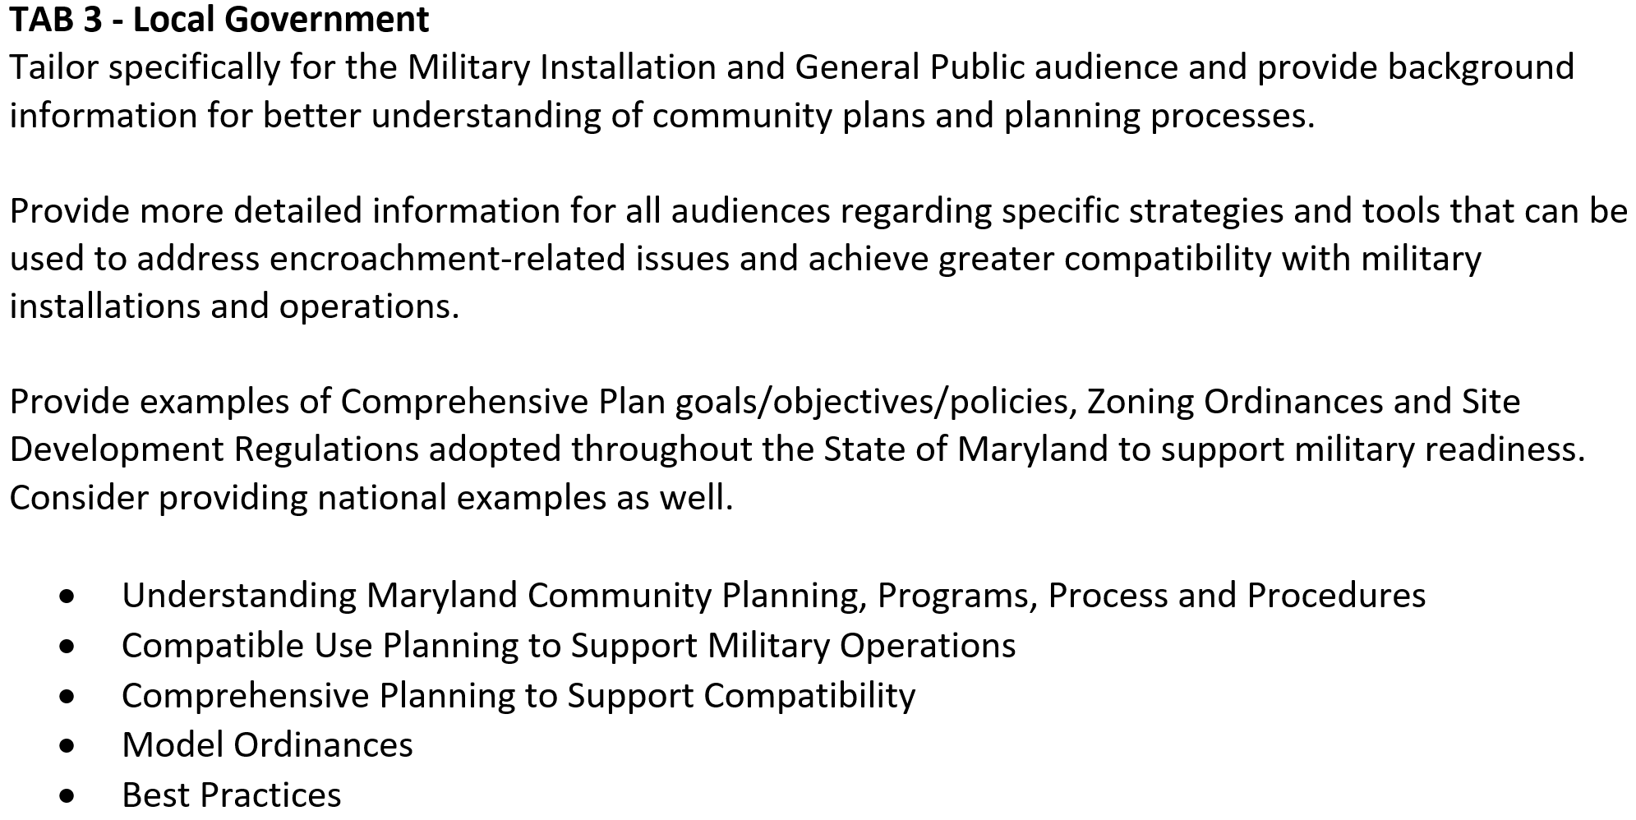

Slide 9


State Agencies

Slide 10
Federal Agencies

Slide 11
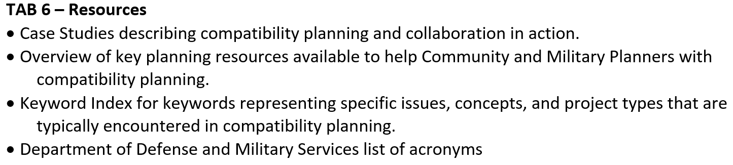
Resources

Slide 12
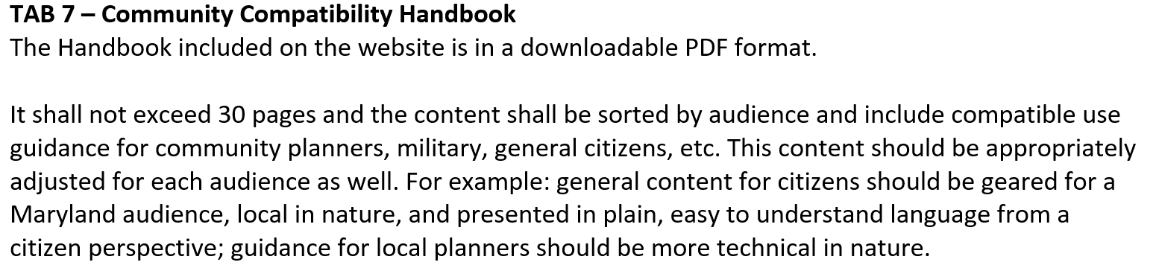
Community Compatibility Handbook

Slide 13
Community Forum

